Slide 1

CSE (H) with specialization in Machine Learning and Artificial Intelligence
Soft Computing (CSF – 332)
Chapter -2.2
Neural Network Optimization Methods
By: Dr. Monika Singh E11032
DISCOVER . LEARN . EMPOWER

Slide 2
Course Objectives
To introduce soft computing concepts and techniques of artificial neural networks, fuzzy sets, fuzzy logic and genetic algorithms
To understand the various techniques from the application point of view.
To analyze various soft computing techniques and decide the technique to be used in a particular problem situation.
To implement soft computing based solutions for real-world problems

Slide 3
Course Outcomes
CO1 | Identify and describe soft computing techniques and their roles in building intelligent. Machines | 1
CO2 | Recognize the feasibility of applying a soft computing methodology for a particular problem. | 2,4
CO3 | Apply fuzzy logic and reasoning to handle uncertainty and solve engineering problems, genetic algorithms to combinatorial optimization problems and neural networks to pattern classification and regression problems. | 3
CO4 | Effectively use modern software tools to solve real problems using a soft computing approach. | 3
CO5 | Evaluate various soft computing approaches for a given problem. | 4

Slide 4
Table of Contents
Loss functions and optimization
Cross entropy loss
Activation function

Slide 5
Neural Network Optimization Methods

Slide 6
Introduction to loss functions
The output of a network or from Activation Functions sometime becomes meaningless without efficient evaluation.
Before listing some functions that might become your ‘finance’ in the future, I want to notice you that there is not a single Loss Function that works for all kind of data.
It depends on a number of factors including the presence of outliers, algorithm, time efficiency of gradient descent, ease of finding the derivatives and confidence of predictions… or maybe an accident.

Slide 7
. Sigmoid or Logistic Activation Function
The Sigmoid Function curve looks like a S-shape. The sigmoid function is a non-linear AF used primarily in feedforward neural networks.
It is a differentiable real function, defined for real input values, and containing positive derivatives everywhere with a specific degree of smoothness.
The sigmoid function appears in the output layer of the deep learning models and is used for predicting probability-based outputs.

Slide 8
Continue:
Some algorithms can be used for both methods with small modifications, such as decision trees and artificial neural networks. Some algorithms cannot, or cannot be adapted easily .
Importantly, the way that we evaluate classification and regression predictions varies and does not overlap, for example:
- Classification predictions can be evaluated using accuracy, whereas regression predictions cannot. - Regression predictions can be evaluated using root mean squared error, whereas classification predictions cannot

Slide 9
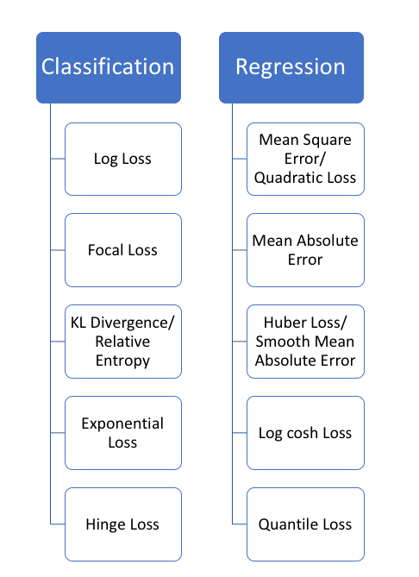
Categories of Loss functions

Slide 10
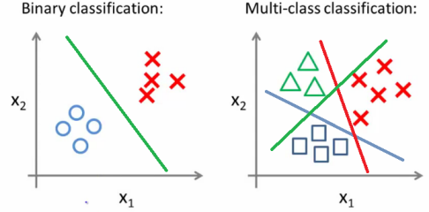
Classification loss
Classification predictive modeling is the task of approximating a mapping function (f) from input variables (x) to discrete output variables (y). The output variables are often called labels or categories. The mapping function predicts the class or category for a given observation.

Slide 11
Continue:
Put an image into the network, it can be classified as belonging to one of two types: “cat” or “not”. That’s called two-class classification or binary classification.
So on, when a problem has more than two classes, or in this case, we want to classify into “cat”, “dog” or any other group, it called multi-class classification problem.
The probabilities can be interpreted as the likelihood or confidence of a given example belonging to each class.
A predicted probability can be converted into a class value by selecting the class label that has the highest probability.

Slide 12
Summary
Requirement of loss functions is being discussed. There are two categories of loss function, i.e., classification loss and regression loss. Classification loss is discussed.

Slide 13
Questions…
What do mean by loss functions
What is the difference between classification and regression loss?
What do you understand by cross entropy loss?

Slide 14

References
Book:
S.N.Sivanandam, S.N Deepa, “Principles of Soft Computing”
Websites:
https://nptel.ac.in/courses/106/105/106105173/
Videos:
https://www.youtube.com/watch?v=mlfM4SGOAgo

Slide 15
THANK YOU
For queries
Email: monika.e11032@cumail.in

